Slide 1
2018 - San Diego
Brief Summary

Slide 2
The Conference
33rd Year
5000 participants
Keynote by Daniel Goldstein, attorney who has worked closely with NFB
Conference presentations
Exhibit hall
W3C Working Group Meetings (including WCAG)
Informal meetings

Slide 3
ETS Presence
7 (6 from research, 1 from IT)
4 Presentations by research
Participated in two co-located W3C Meetings
Note: Pearson had 13 staff, 4 presentations, and exhibit NWEA had 2 staff College Board at least 1

Slide 4
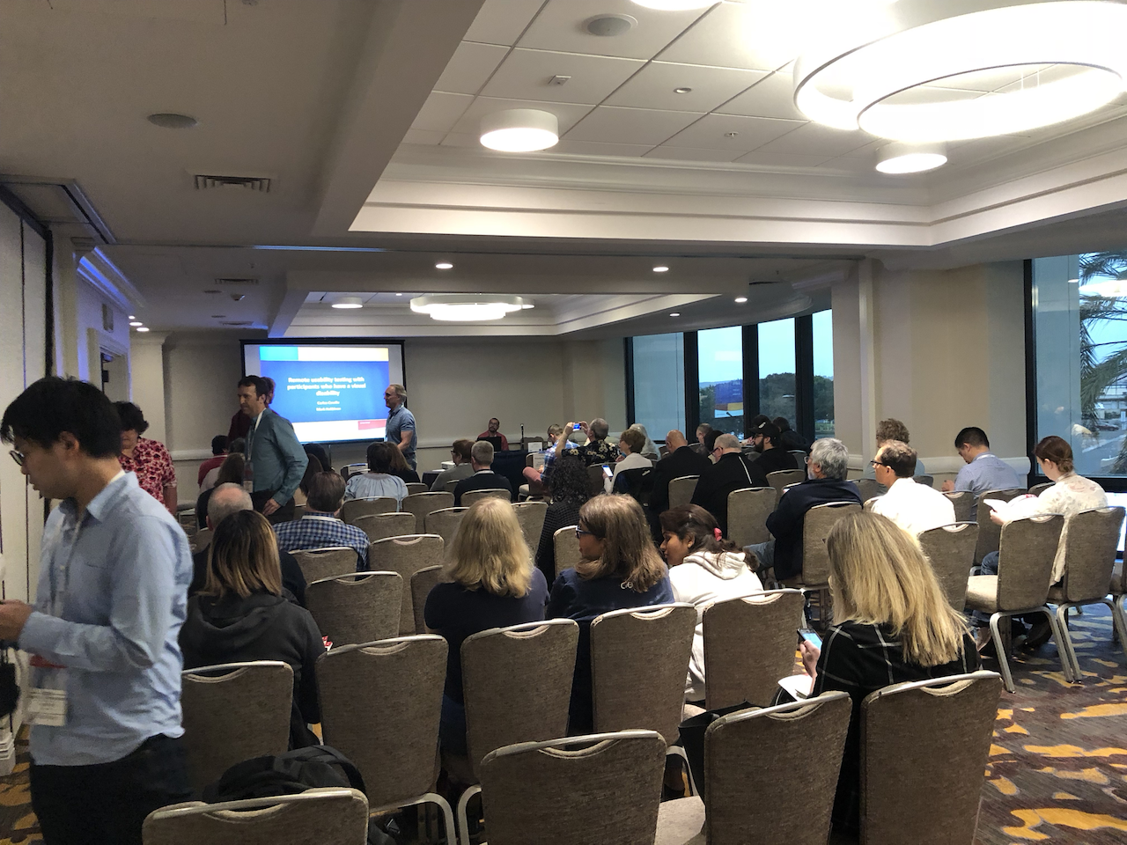

Slide 5
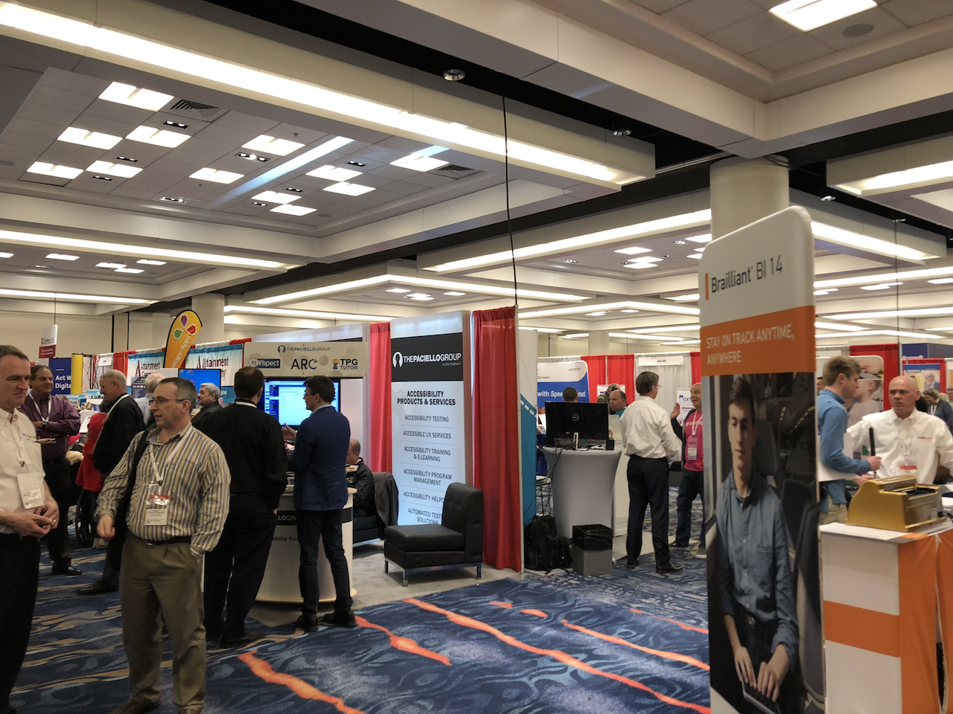

Slide 6
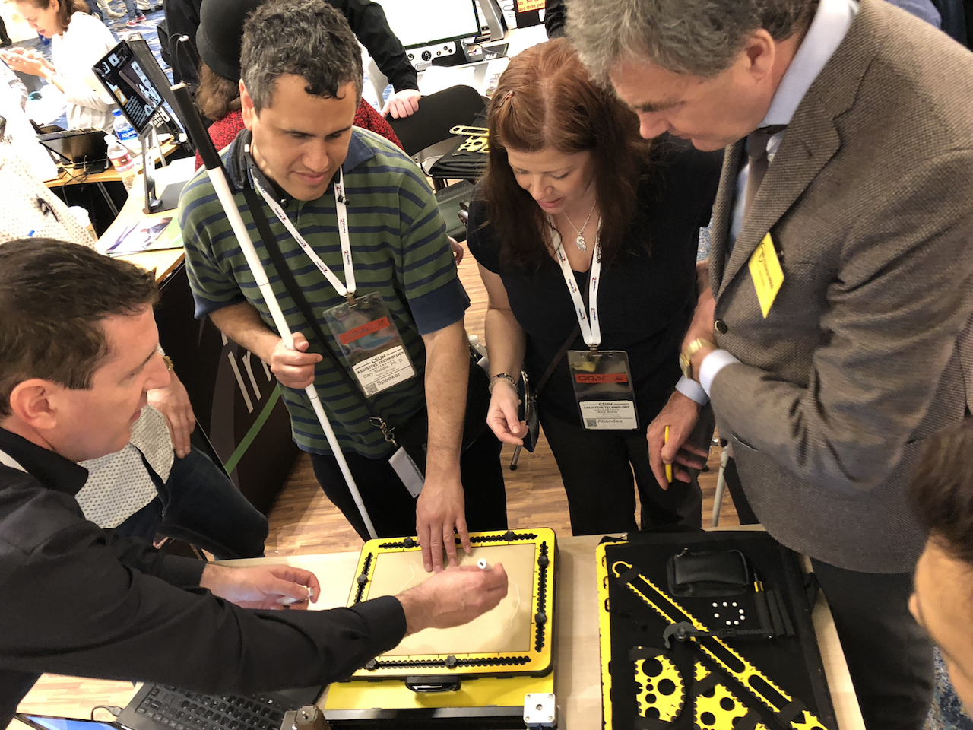

Slide 7
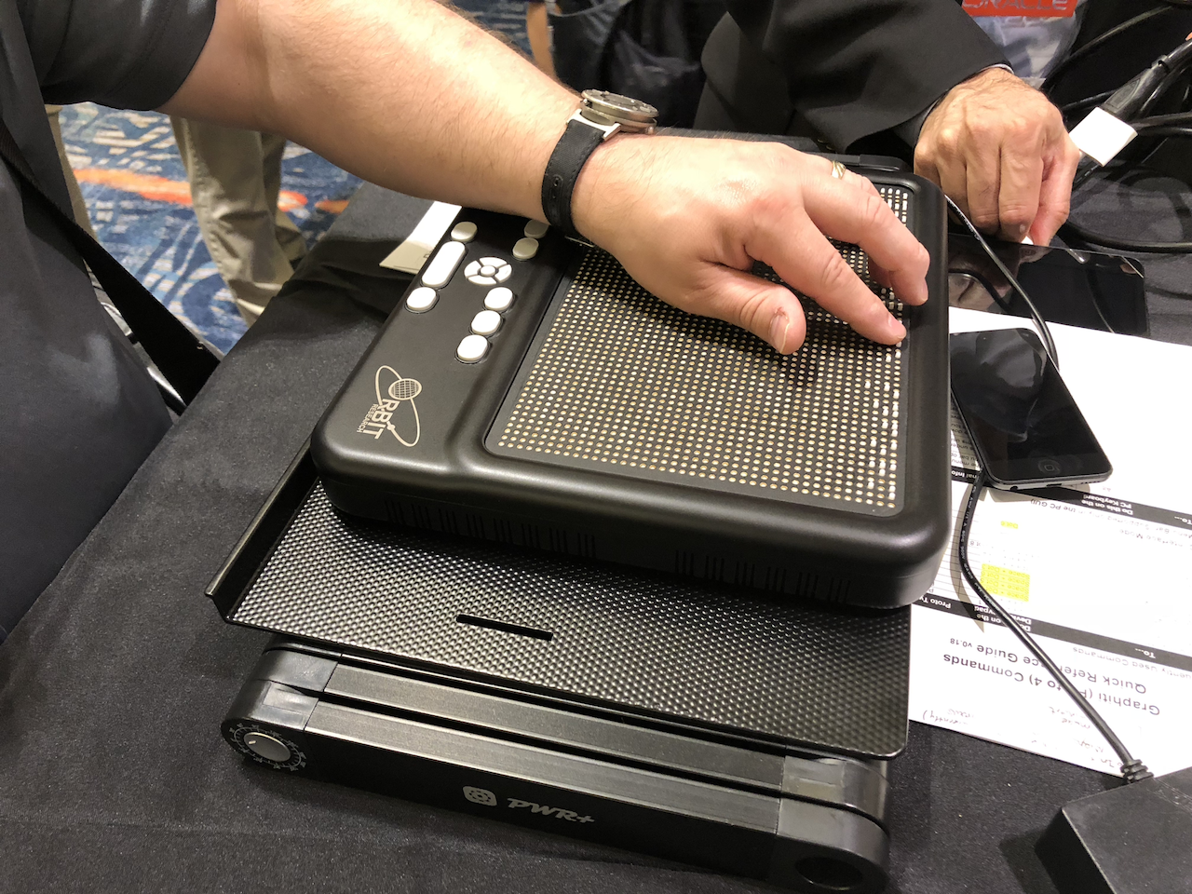

Slide 8
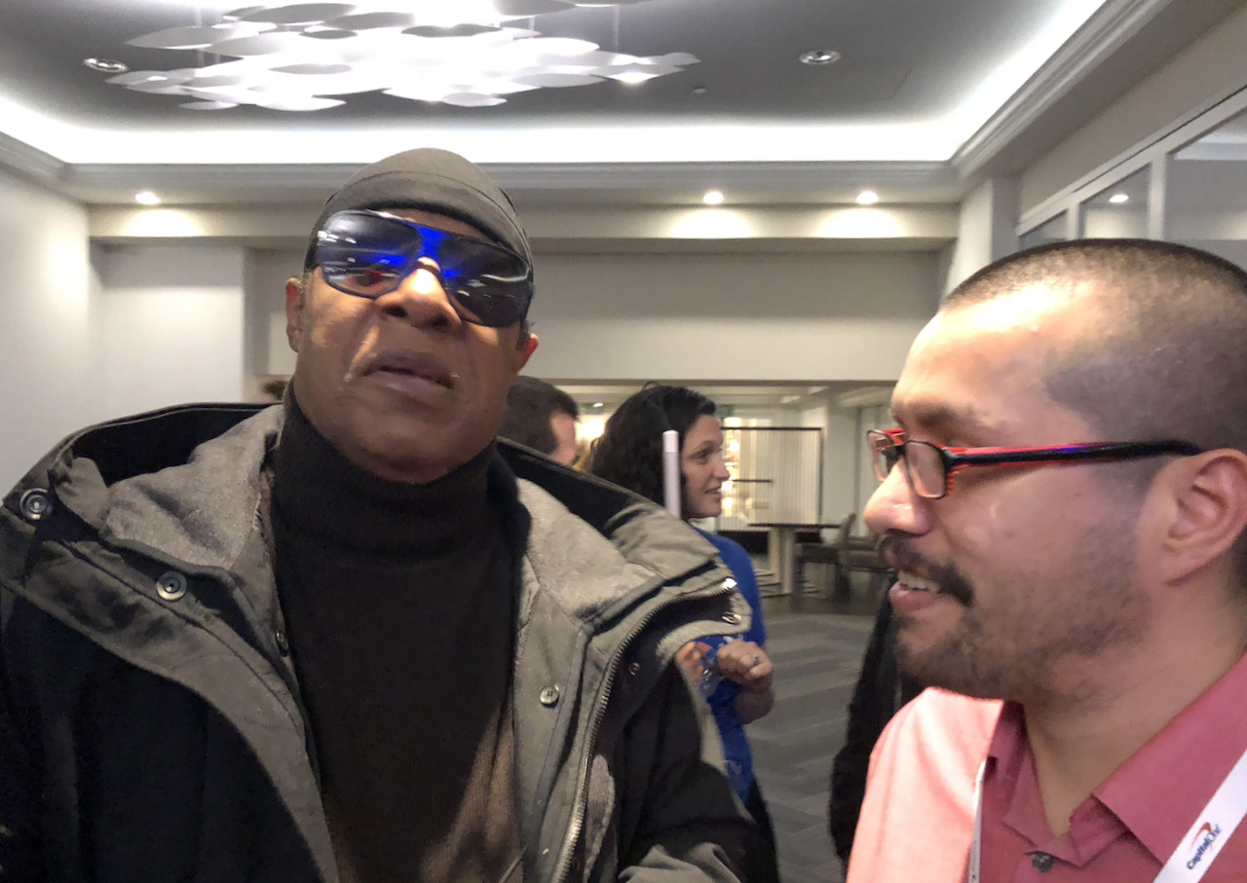

Slide 9
Some Highlights
Intense discussion on WCAG 2.1 as it nears publication as standard
Section 508 Refresh and VPAT 2.1
Progress on SSML for assistive technologies
Good meetings with VFO
SSRS discussions with Microsoft
Intelligence gathering
And more…

Slide 10
Next Month…
CSUN Conference Knowledge Sharing Event
Lounge A – Date TBD

